Slide 1
Cloud Technology Fundaments 21UCA501

Slide 2
IaaS
Iaas is also known as Hardware as a Service (HaaS). It is one of the layers of the cloud computing platform. It allows customers to outsource their IT infrastructures such as servers, networking, processing, storage, virtual machines, and other resources. Customers access these resources on the Internet using a pay-as-per use model.
In traditional hosting services, IT infrastructure was rented out for a specific period of time, with pre-determined hardware configuration. The client paid for the configuration and time, regardless of the actual use. With the help of the IaaS cloud computing platform layer, clients can dynamically scale the configuration to meet changing requirements and are billed only for the services actually used.

Slide 3
IaaS
IaIaaS cloud computing platform layer eliminates the need for every organization to maintain the IT infrastructure. IaaS is offered in three models: public, private, and hybrid cloud. The private cloud implies that the infrastructure resides at the customer-premise. In the case of public cloud, it is located at the cloud computing platform vendor's data center, and the hybrid cloud is a combination of the two in which the customer selects the best of both public cloud or private cloud.
IaaS provider provides the following services -
Compute: Computing as a Service includes virtual central processing units and virtual main memory for the Vms that is provisioned to the end- users.
Storage: IaaS provider provides back-end storage for storing files.

Slide 4
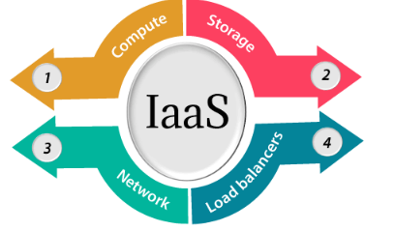
IaaS
Network: Network as a Service (NaaS) provides networking components such as routers, switches, and bridges for the Vms.
Load balancers: It provides load balancing capability at the infrastructure layer.

Slide 5
IaaS
Advantages of IaaS cloud computing layer
There are the following advantages of IaaS computing layer -
1. Shared infrastructure
IaaS allows multiple users to share the same physical infrastructure.
2. Web access to the resources
Iaas allows IT users to access resources over the internet.
3. Pay-as-per-use model
IaaS providers provide services based on the pay-as-per-use basis. The users are required to pay for what they have used.
4. Focus on the core business
IaaS providers focus on the organization's core business rather than on IT infrastructure.
5. On-demand scalability
On-demand scalability is one of the biggest advantages of IaaS. Using IaaS, users do not worry about to upgrade software and troubleshoot the issues related to hardware components.

Slide 6
THANK YOU

